Slide 1
Module 24: Configuring Applets
Siebel Core Developer and Technology School
Notes:
Time: Lecture: 45 minutes; labs: 40 – 50 minutes
Intent: To learn how to create and modify list and form applets
Flow: Describe list and form applets. Build a list applet using the wizard. Use the Web layout editor to modify a list applet. Discuss symbolic strings. Build a form applet using the wizard. Use the Grid Layout Editor.
Key Terms:
List Applet wizard
Form Applet wizard
Web Template
Base Mode
Edit Mode
EditList Mode
Symbolic Strings
Applet Form Grid Layout template
Grid Layout Editor
Web Controls Toolbar
Please note: Faculty-specific notes are italicized.

Slide 2

Module Objectives
After completing this module you will be able to:
  Create and modify a list applet
  Create and modify a form applet
Why you need to know:
  You may want to display new data in the UI

Slide 3
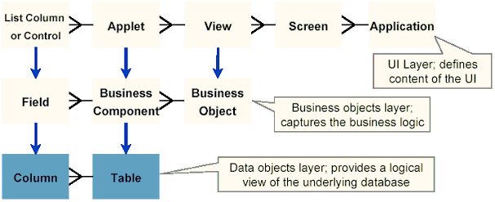
Applet Definition
Data entry form composed of controls
Provides viewing, entry, modification and navigation capabilities for data in one business component
Notes:
An applet is a data entry form, composed of controls, that occupies some portion of the Siebel application window. An applet can be configured to allow data entry, provide a scrolling table of data rows, or display business graphics, a navigation tree, or a Web browser. It provides viewing, entry, modification, and navigation capabilities for data in one business component.
An applet is always associated with a business component. Although the same business component can be associated with multiple applets, an applet is associated with only one business component.

Slide 4
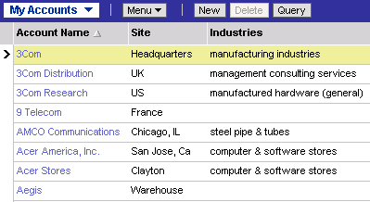
Primary Applet Types
List applet
  Displays one or more records simultaneously in a list
  Fields for one record are displayed in a single row
  Typically displays fewer fields due to width of monitor viewable area
  Supports drilldown to other views through hyperlinked fields
Notes:
Now let us begin our discussion with a definition of List Applets and Form Applets; A list applet allows simultaneous display of data from multiple records. It presents business component information in a list table format with each record of data represented in a row. In addition to textual data, lists also support images in .jpg and .gif formats and edits control such as check boxes, dropdown lists, non-editable MVGs, and text fields.

Slide 5
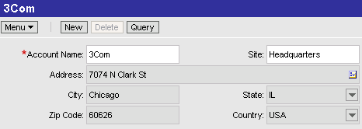
Primary Applet Types Continued
Form applet
  Displays a single record
  Fields for the record are displayed in a grid or form
  Can show more fields at once than a list applet
Notes:
A form applet presents business component information in a data entry form layout. Users enter data using text boxes, check boxes, buttons, and similar visual constructs known collectively as controls. The fields for the record are displayed in a grid or form therefore more fields can be displayed at any one time in a form applet than a list applet

Slide 6
Creating a List Applet
Follow these steps to create a new list applet …
…Or use the List Applet wizard
  Automates these steps
  Generally the preferred method
1. Create new applet object definition
2. Associate applet template with object definition
3. Bind controls and list columns to template
Notes:
This is a positioning slide. The process of creating a list applet is covered in detail in the following slides.
There are two ways to create an applet:
You can either go through the individual steps to creating the applet manually which would require you to create a new object definition and associate the applet template with the applet object definition then you would need to bind controls to the applet. This can be a laborious process which is unnecessary.
Siebel 7.7 provides you with the functionality to use a List Applet Wizard to create an applet which automates all the steps defined above. As this is generally the preferred method, we will describe using the list applet wizard in greater detail in the following slides.
The wizard is very valuable because creating a list applet manually can be tedious, in addition to it being easy to forget details.

Slide 7
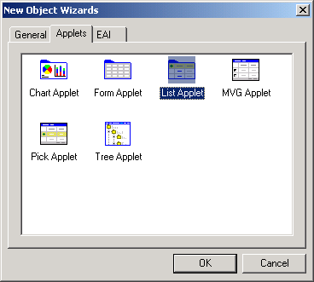
List Applet Wizard
Ensures object definitions and properties are created
  Ensures steps are not omitted
Increases developer productivity
  Speeds project completion
To invoke the List Applet wizard, select File > New Object
  In the Applets tab, select List Applet and click OK
Notes:
This is an overview of the List Applet wizard, including some advantages to using it. The next seven slides step through the process.
There are many benefits to creating a list applet using the list applet wizard. The list applet wizard ensures correctness when creating list applets as steps can not be omitted in the process. Human error is always a high risk factor when creating things like list applets and using the list applet wizard reduces this risk. In addition to the reduced risk, productivity can be improved by using the list applet wizard as it automates the process which is always faster than manually stepping through all the required tasks in creating the object.
The steps needed to invoke the list applet wizard are as follows:
Select File >New Object from the Siebel Tools main menu. The New Object Wizard dialog box will be displayed on the screen.
You will then need to click the Applets tab, and then double-click the List Applet icon. Now the General page of the List Applet Wizard appears which will be discussed in the next slide.
Demo: Demonstrate the wizard as you step through the following slides

Slide 8
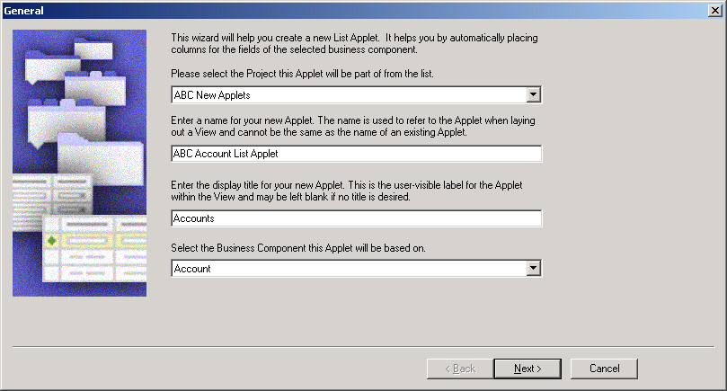
Using the List Applet Wizard
Use the List Applet wizard to create a new list applet
Select the project, enter the name for the applet, enter the display title for the applet, and select a business component
  Creates an applet object definition in Tools
Notes:
The first screen that you are prompted with after selecting the List Applet Wizard is the General page and it is displayed above. This screen allows you to enter the project and business component for which the applet will be based on. Only locked projects appear in the picklist.
This screen is also where you would enter the name of the new applet. You must note that the applet name must be a unique name that has not already been used by another applet in the system. It is used to refer to the applet when laying out a view.
The last thing that you can specify in this screen is the display title for the new applet. This is the name to appear in the user interface and may be left blank if no title is desired. The wizard will use this information to create an applet object and define the required applet properties.
Once you have entered all the necessary values in this screen, you can press ‘Next’ to be taken to the next step in the List Applet Wizard.
Demo: Point out that only locked projects are available. Point out the pre-defaulted values for the applet name and title.

Slide 9
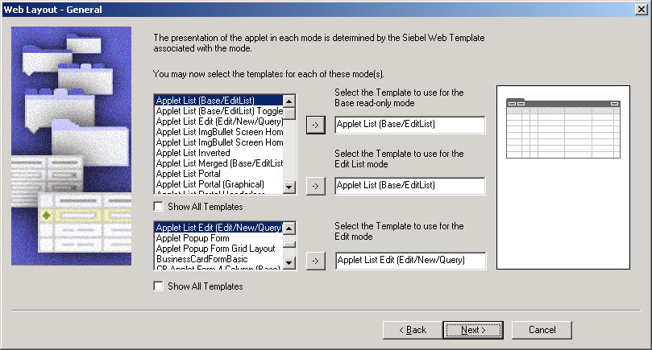
Using the List Applet Wizard Continued
Select Web templates for each mode
  Base and EditList mode are commonly built using Applet List (Base/EditList)
  Edit mode is commonly built using Applet List Edit (Edit/New/Query)
Notes:
This next screen in the list applet allows you to enter the Web templates to use for the applet. The presentation of the applet in each mode is determined by the Siebel Web Template. This section asks you to select templates for each type of edit mode for the applet and once you have done that, it associates the template with the applet.
Associating a template and an applet in Tools lets the program know which template(s) to use for the applet. Please note that a thumbnail image for many templates appears when you select the template name.
Two good techniques for picking a template are to either find an existing applet with a layout similar to what you want, or Select Web Templates in the OE, click a likely-looking template name, right-click, and select View Web Layout. This should be done before you start the wizard.
There is a check box just below the list of templates called “Show All Templates”. When checked, all the templates available on the system are displayed. If left unchecked, you will only be able to see the templates that associate to list applets.
Once you have selected all the necessary values in this screen, you can press ‘Next’ to be taken to the next step in the List Applet Wizard.
Demo: Click the Show All Templates option on and off to demonstrate the difference.

Slide 10
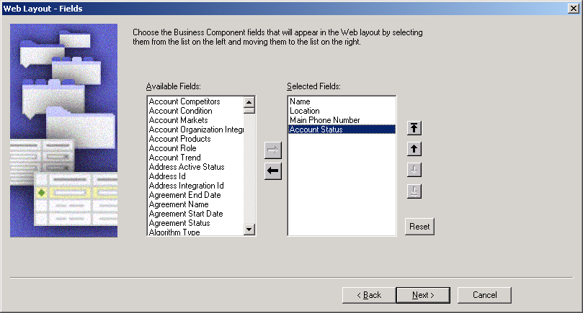
Using the List Applet Wizard Continued
Choose the business component fields to appear in the Web layout
Notes:
This third screen in the List Applet Wizard displays the Web Applet – Fields screen. This screen in the wizard allows you to choose the business component fields that will appear in the web layout. The way to select the fields is to select the required field from the Available fields list and press the forward arrow button to move the field to the selected fields list. In order to arrange the order of the fields to show in the applet you can use the up and down arrow buttons to the right of the selected fields list.
The fields that appear in the Available pane are those fields defined for the business component that you selected in the earlier part of the wizard. It is a good idea here to add all the columns in the business component to the web layout. It is a lot easier to delete them later as necessary rather than having to add them in.
This step in the procedure creates the applet web template items and is necessary to bind the controls to the applet. Once you are done selecting your fields and ordering them, you can press the next button to go to the next screen in the wizard.
Demo: Point out that you might want to add fields, and then selectively remove them using the Web Layout Editor. This way you can have different fields appear in different modes of the same applet.

Slide 11
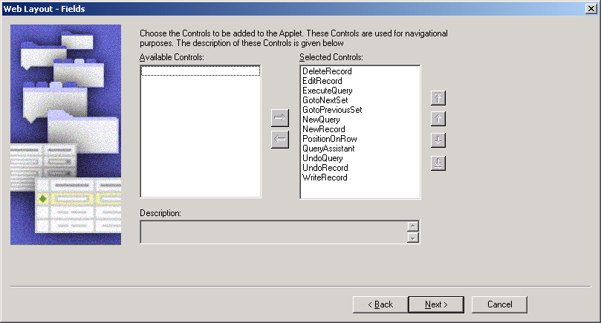
Using the List Applet Wizard Continued
Select additional controls to be added to the applet
  By default, all of the standard buttons are selected
Notes:
In the second Web Layout-Fields page, choose the controls in the Available Controls box that you want to appear on the applet. Again the way to select the controls is to select the required controls from the Available controls list and press the forward arrow button to move the control to the selected controls list. In order to arrange the order of the controls to show in the applet you can use the up and down arrow buttons to the right of the selected controls list. The vertical sequence of the controls in this screen of the wizard determines their sequence from left to right in the resulting list applet. It is easier to set the sequence here than reorder them in the Edit Web Layout editor.
All the entries in the Selected Controls box are added by default. If you wish to exclude some of the controls and move them to the Available Controls box, select the controls and click the activated arrow.
Customers will select all controls in almost all cases.
New controls may be added to the Model HTML Controls applet if a customer creates a custom button or other control.
If a customer elects not to use a piece of standard functionality, such as the Query Assistant, the control should not be removed in the wizard, but from the applet Web template. This makes it easier to add the functionality back to the applet in a later phase.

Slide 12
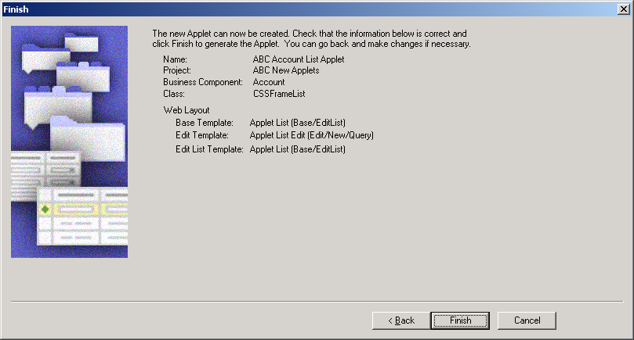
Using the List Applet Wizard Continued
Review the properties you have selected
Notes:
This wizard screen only gives details of the applet object, not the list columns and controls. If you need to review them, use the Back button.

Slide 13
Using the List Applet Wizard Continued
Finishing the list applet
Creates required object definitions for:
  Applet
  Control
  List
  List column
Associates applet Web templates to the Applet
Binds list columns to the templates
  Appear as applet Web template items
Sets applet class to CSSFrameList
Invokes the Web Layout Editor
Notes:
Once you press the Finish button in the List Applet Wizard, the wizard will automatically create required object definitions for the Applet, the controls, the list and the list column.
The wizard will also map all Applet Web Templates and Applet Web Template items. The applet class will be defaulted to the CSSFrame List and the Web Layout Editor will be invoked. There will be no need for you to do any of this manually from here.
The last thing the wizard does is start the Web Layout Editor

Slide 14
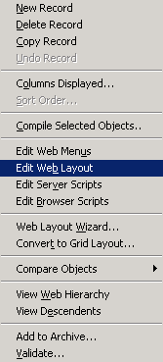
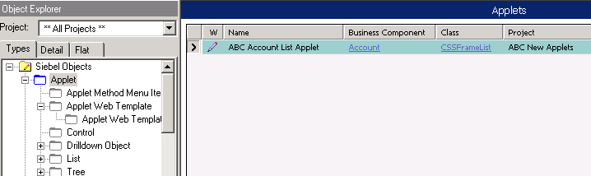
Web Layout Editor
Is used to add, remove, and reorder applet Web template items
Is invoked automatically upon completion of the List Applet wizard
Can be invoked from the right-click menu
  Edit Web Layout Editor
Right-click to invoke Edit Web Layout Editor
Notes:
Now once the wizard has finished creating the applet you can use the Web Layout Editor to rearrange the layout of list columns or controls as necessary.
The wizard automatically opens the Web Layout Editor after completing the List Applet but if you need to manually invoke the Web Layout Editor you must navigate to the Applet Object Definition in the Object Explorers window and select the applet that the Wizard has just created. Place your cursor on the applet definition and right click on the mouse. The right click functionality will display a menu with a number of different options. You should select Edit Web Layout Editor from here, this will take you to the Web Layout editor where you can add, remove and reorder the columns displayed.
In order to add columns and controls, you should drag them from the Controls/Columns toolbar and onto the Web Layout Editor. In order to delete columns or controls you should select what you wish to delete and right click on the mouse and select the delete option.

Slide 15
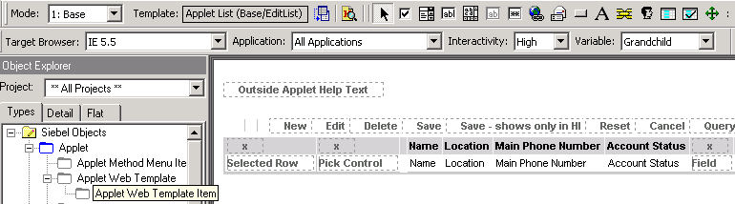
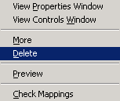
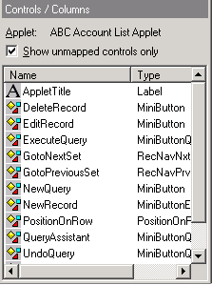
Web Layout Editor Continued
Use the Web Layout Editor to lay out the applet
  Placeholders correspond to item identifiers of applet Web template Items
Displays the layout of the selected mode
To add, drag and drop items from the controls/columns window
Select and right-click to delete columns

Slide 16
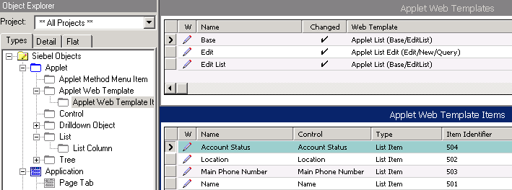
Applet Web Templates
Specify which template is used when the applet is displayed in a given mode
Contain applet Web template Items
  The controls or list columns that have been bound to the template
  The item identifier that describes where in the applet the controls or list columns should appear
Specifies where the list column will appear

Slide 17
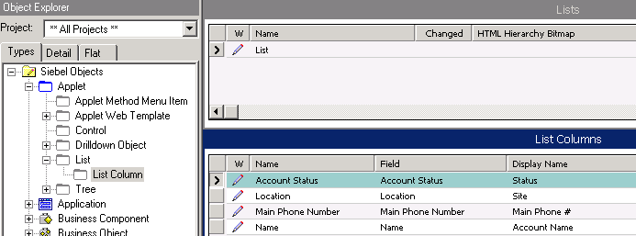
List Column Definitions
Specify
  The field that is displayed
  The display name that appears at the top of the list column
    May reference a symbolic string
Notes:
The Display Name property is read only and can be updated in one of two ways: by setting the Display Name – String Override, or by selecting the Display Name – String Reference from the picklist. The next three slides give detail on symbolic strings.

Slide 18
Symbolic Strings
Are stored in the repository containing words and phrases used in UI definitions
  Global Dictionary contains many commonly used terms
Make sure that the same name appears exactly the same way throughout the application
  Symbolic String Locale object type allows language translation
Are used by user interface objects such as:
  Labels
  List Columns
  Applet Title
Notes:
Symbolic Strings are text values which are referenced by user interface definitions such as controls and list columns.
Demonstrate the Symbolic String object type in Tools. Show that there is a record for each text value that appears in the user interface. Show that there are occasionally duplicate values for commonly used strings.

Slide 19
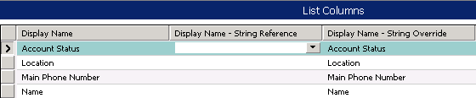
Using Symbolic Strings
String references
  Refer to symbolic string object definitions
  Are selected from a picklist
  Refers to the name of the symbolic string
String overrides
  Are used for exceptions when strings are infrequently displayed
  Can be converted to symbolic strings using a Siebel supplied string conversion utility
Notes:
Text properties are read only. Developers can select a symbolic string for a text property by selecting “<property name> - String Reference”. For example, Display Name is read-only, but Display Name – String Reference has a picklist from which developers can select the appropriate symbolic string.
In cases where a symbolic string for the desired text value does not exist, developers can either create a new symbolic string or type in a value for text properties in a property called “<property name> - String Override”. For example, Display Name is read-only, but Display Name – String Override can be edited.
Both will be demonstrated in the labs

Slide 20
String Conversion Utility
Is provided in your Tools\bin directory
  Strconv.bat
Allows symbolic strings to be exported and imported
Allows translation outside the Siebel application
Can be used to convert string overrides to symbolic strings later in a configuration project
Notes:
One benefit of the string conversion utility is that it allows symbolic strings to be exported to a file, then translated in another application. The file can then be imported back to the Siebel application with translated values for the appropriate language.
Another benefit of the string conversion utility is that it allows developers to export string overrides and re-import them as string references.

Slide 21
Lab
In the lab you will:
  Create a new list applet using the wizard
Notes:
See instructions for lab 24-1, Create a List Applet

Slide 22
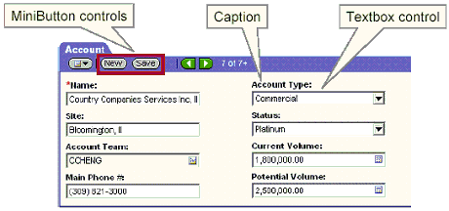
Form Applet
Displays one record at a time in a data entry form layout
  Field controls display fields in the business component
    Field Caption property displays caption text
  Button controls initiate an action when clicked
Notes:
Now that we have fully described list applets and how they are created using the List Applet Wizard, we can continue our discussion with Form Applets.
We have already explained form applets at the beginning of this module but just to recap, a form applet presents business component information in a data entry form layout. In a form applet users would enter data using text boxes, check boxes, buttons, and similar visual constructs known collectively as controls.
Field controls on the form applet display fields in the business component containing data stored on the tables. Above each field control is a field caption which displays some caption text that describes the data that the associating field control contains.
Also on a form applet are button controls. These controls initiate an action when clicked such as allowing you to create a new record when you press the new button control and allowing you to explicitly save the record when you press the save button control. The backward and forward button controls allow you to scroll backwards and forwards between records in the business component when pressed.

Slide 23
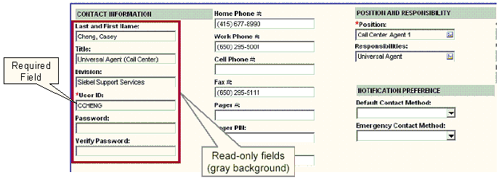
Form Applet Appearance and Function
Fields are usually editable
  Can be read-only
Allows scrolling one record at a time
Notes:
Now you should start to get familiar with the appearance of Form applets. What you will notice is that there are lots of fields on the form applet representing one field on the business component. If no editing controls have been placed on the fields then you should be able to edit each field that is displayed.
You will know if a field is Read-only as the field will have a slightly shaded background therefore not allowing you to edit its value. When you press the backward or forward button control you can scroll backward and forward between the records on the business component one record at a time.
One more important thing to point out about Form applets is that when a field is a required field, there will be a red asterisk beside the label marking it as a required field. When a field is a required field, you cannot save a record (either new or modified) if any of the required fields do not have data contained in them.

Slide 24
Expanding and Collapsing Form Applets
Collapsed (“Less”)
  Is the default display
  Shows limited set of fields
  Only displayed fields can be edited
Expanded (“More”)
  Shows all fields
  Full edit capabilities (all unprotected fields can be edited)
User can toggle using the show more button
Notes:
One more concept we would like to introduce in form applets is Expanding and Collapsing form applets. All forms appear with the Show More button, shown in the above slide, in the top right corner. Use this button to expand or collapse the form. This allows you to look at more or fewer fields in a record, according to your needs and the state of the form. The expanded form shows all the fields of a record. Your system administrator determines what fields appear in the expanded form and in the collapsed form.
When you first enter a form applet, you will see it in its default display which is in the Collapsed display. This display shows a limited set of fields on the form and all the fields that are displayed can be edited. When you press the Show More button, all the fields on the form are displayed, hence you are viewing the form in it’s “Expanded” display.

Slide 25
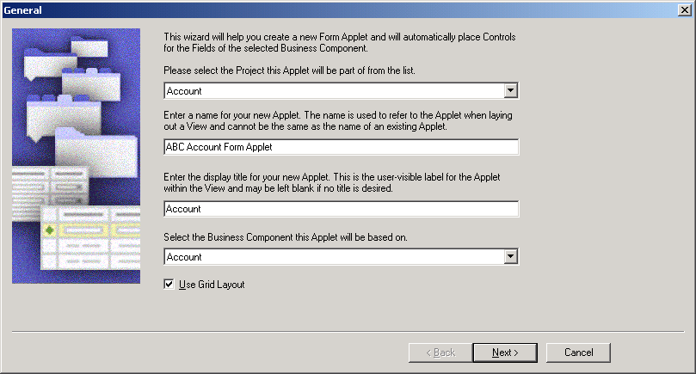
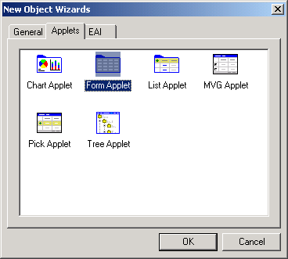
Create a New Form Applet
Use the Form Applet wizard to create a new form applet
Select the project, enter the name for the applet, enter the display title for the applet, and select a business component
Notes:
Now that we have described form applets, we will now explain how to create a form applet using the Form Applet Wizard. The Form Applet Wizard helps you define all the correct properties and automatically creates child objects, such as Web Template Items, based on the information you enter. You can also create applets manually by defining all the necessary properties and child objects. The Form Applet Wizard does the following:
Creates the form applet
Creates the applet Web template
Creates the controls
Maps controls to Web templates by creating Applet Web Template Items
In order to create a Form Applet using the Form Applet Wizard:
Choose File >New Object from the Siebel Tools main menu. The New Object Wizard dialog box appears.
Click the Applets tab, and then double-click the Form Applet icon. The General page of the Form Applet Wizard appears.
Now we have already described the General page of the List Applet Wizard in this section but now we will describe the General page of the Form Applet wizard.
This is the first screen that you are prompted with after selecting the Form Applet Wizard is the General Page and it is displayed above. This screen is very similar to the List Applet Wizard General page as it allows you to enter the project and business component for which the applet will be based on. Only locked projects appear in the picklist. This screen is also where you would enter the name of the new applet. Once again, the applet name must be a unique name that has not already been used by another applet in the system. It is used to refer to the applet when laying out a view. The last thing that you can specify in this screen is the display title for the new applet. This is the name to appear in the user interface and may be left blank if no title is desired.
Demo: Demo the Form Applet wizard as you step through these slides.

Slide 26
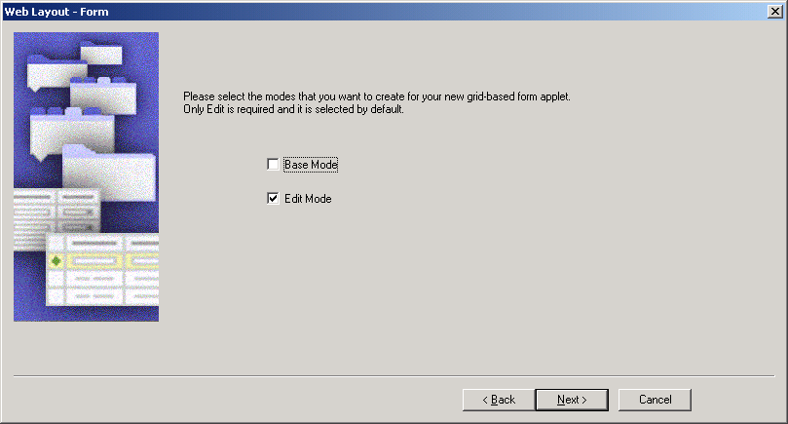
Create a New Form Applet Continued
Select the modes to use
  Edit mode is required for all clients
    Uses the Applet Form Grid Layout template
  Base mode is required for Standard Interactivity clients only
Notes:
Form Applets typically use the Applet Form Grid Layout template. This allows greater functionality in editing, formatting, and sizing of controls.
Form Applets are typically configured for Edit Mode only. To configure an applet for Base Mode, you may check the box in the wizard. Customer applications occasionally display form applets in base mode.

Slide 27
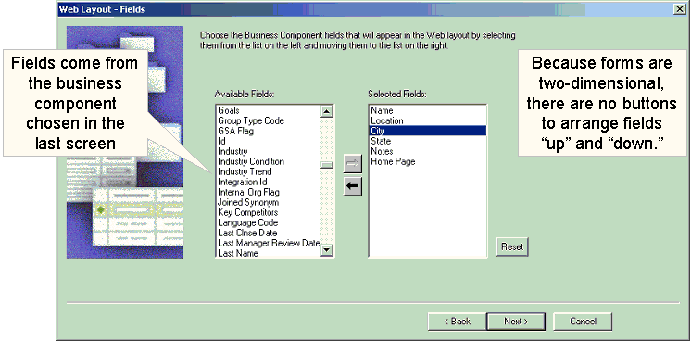
Create a New Form Applet Continued
Choose the business component fields to appear in the Web layout
  Creates controls and binds them to the applet Web templates
Notes:
The next page that you are displayed with is the Web Layout – Fields page. In the Web Layout - Fields page, select the fields that you want to appear on the applet and then click Next.
The fields that appear in the Available pane are those fields defined for the business component that you selected in Step 1. This screen of the wizard solicits data to create and associate the correct applet Web template item object definitions with the applet object definition.
It is important to note that you can’t set the order for the fields in this wizard, except by picking the fields in order. Using the Web Layout Editor to arrange the fields correctly is more important with form applets than it was with list applets and you should note that there is no “Columns Displayed” option for form applets.

Slide 28
Create a New Form Applet Continued
Select additional controls to be added to the applet
  By default, all of the standard buttons are selected
Notes:
The students saw a similar dialog in the list applet wizard.

Slide 29
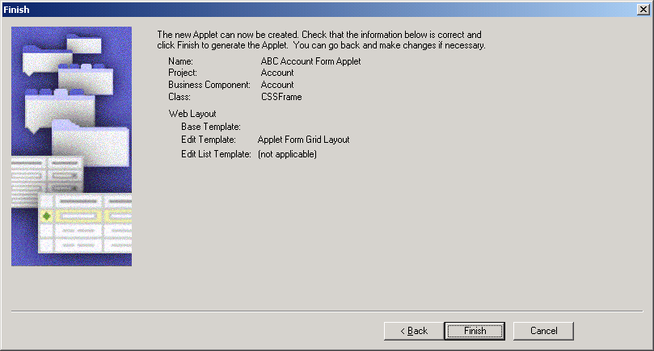
Create a New Form Applet Continued
Review the properties you have selected
Notes:
Review the information displayed in the Finish page, displayed above, and then click Finish.
The Form Applet Wizard creates the applet and supporting object definitions based on the selections you made. If you need to review or change information in any of the previous screens, you can return to previous pages by clicking the Back button.

Slide 30
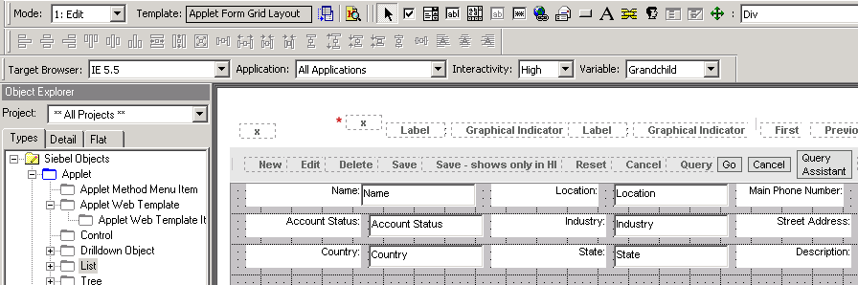
Grid Layout Editor
Is used to:
  Create new control object definitions
  Bind controls to the Web template
  Resize controls
  Reposition controls
Notes:
The Grid Layout Editor is used to lay out form applets. The next several slides describe features of the Grid Layout Editor.

Slide 31
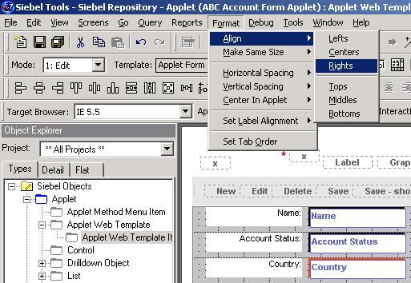
Grid Layout Editor Continued
Allows drag-and-drop layout editing
Supports formatting options such as:
  Align controls
  Make same
  size
  Horizontal
  spacing
  Vertical
  spacing
Notes:
Demonstrate these functions by moving an existing control, or dragging a new control from the toolbar, onto a form applet, manually resizing it, then using Make Same Size, Align – Bottoms, and Align – Lefts to resize and reposition the control.

Slide 32
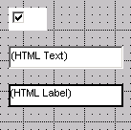
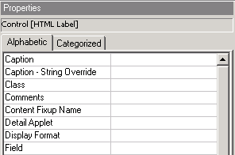
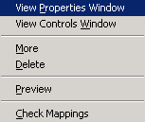
Web Controls Toolbar
Supports the drag-and-drop creation of controls
Contains icons for:
  Text controls
  Checkboxes
  Labels
Right click to set properties
Notes:
The Web Controls toolbar should be displayed automatically when the Grid Layout Editor is open. If it is not, it can be displayed by selecting View > Toolbars > Web Controls Toolbar.
Developers may choose to drag and drop controls from the toolbar to the grid layout editor, or create controls manually in Applet :: <Applet Name> | Controls.
If controls are created manually, both a label control and text box control will be available in the Controls/Columns window of the Grid Layout Editor.

Slide 33
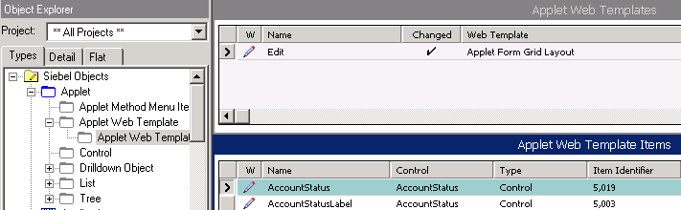
Applet Form Grid Layout
Is the template used for form applets
Allows data to be laid out in a grid
  Item identifiers specify the grid location of the control
Notes:
The Applet Form Grid Layout Web template was discussed in the previous module.
Unlike list applet Web template items, where the Item Identifier specifies a placeholder in the template where a control or list column will appear, the Item Identifier references the location in the grid where the upper-left corner of the control will appear.

Slide 34

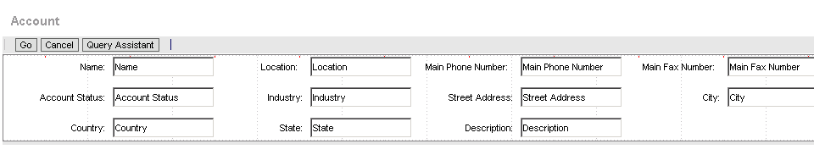
Preview the Applet
Right-click and select Preview to see how the applet appears
  When finished, right-click and deselect Preview to return to the Grid Layout Editor
Right click to preview the applet
Notes:
New users may inadvertently close the grid layout editor instead of leaving preview mode by deselecting Preview from the right-click menu.
Demo: Demonstrate Preview, and how to exit preview.

Slide 35
Summary
This module showed you how to:
  Create and modify a list applet
  Create and modify a form applet
Notes:
Review Question: What’s the best way to create a list applet?
Answer: Use the List Applet wizard.
Review Question: How can one invoke a wizard?
Answer: Select File > New Object and select the appropriate wizard.
Review Question: What template is usually used by form applets?
Answer: The Applet Form Grid Layout template

Slide 36
Lab
In the lab you will:
  Modify a form applet using the grid layout editor
Notes:
See lab instructions for details.

